Slide 1
MT104-Linear Algebra

Slide 2
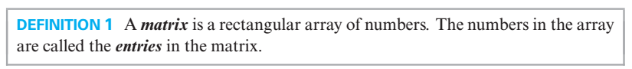

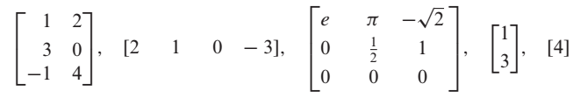
A

Slide 3
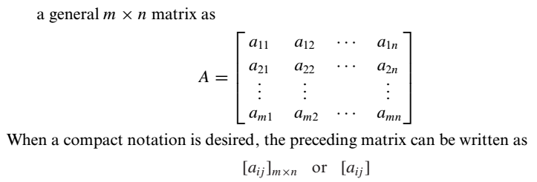
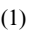
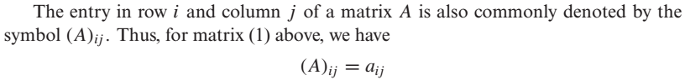
A
is

Slide 4
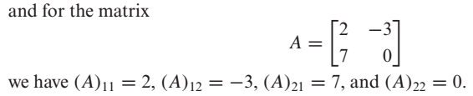

Slide 5
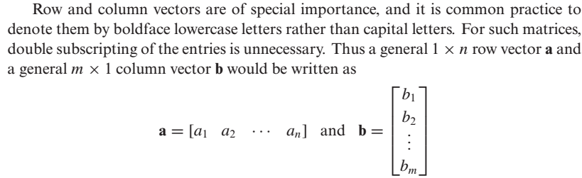
Row Vector and Column Vector

Slide 6
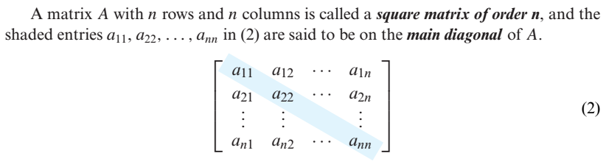
Square Matrix and Main Diagonal

Slide 7

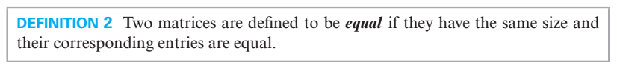
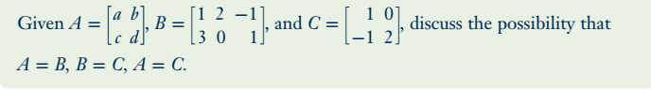
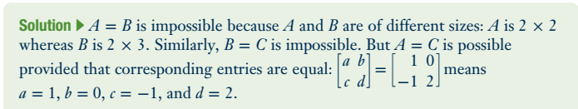
Problem

Slide 8
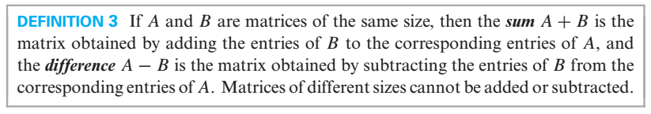
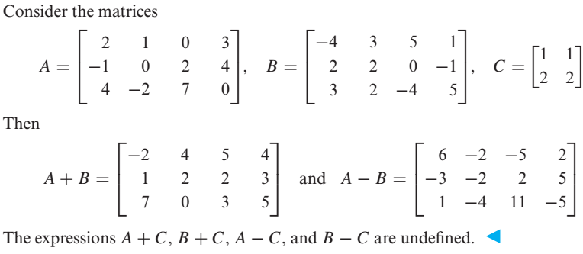

Slide 9
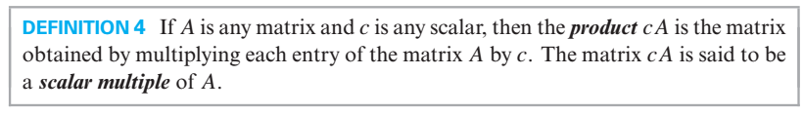
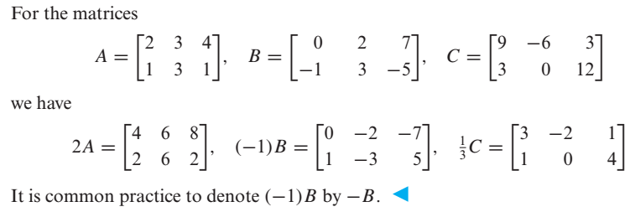
Scalar Multiples of a Matrix

Slide 10
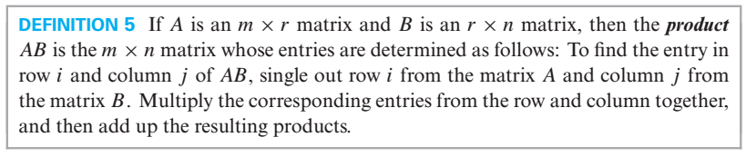
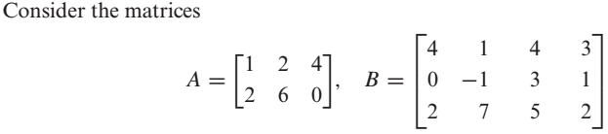
Product of Two Matrices

Slide 11
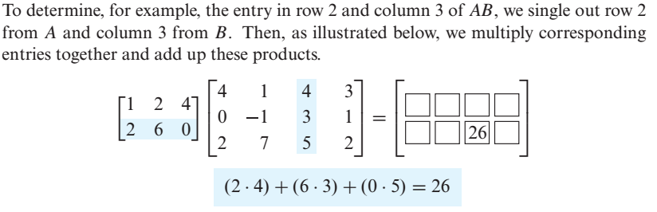
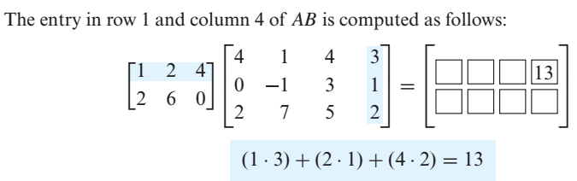

Slide 12
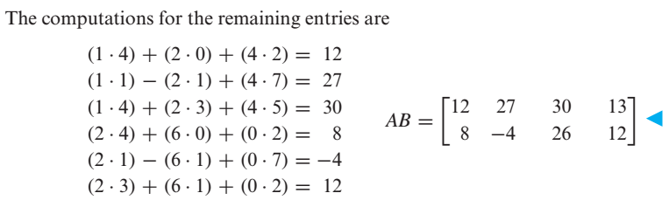

Slide 13
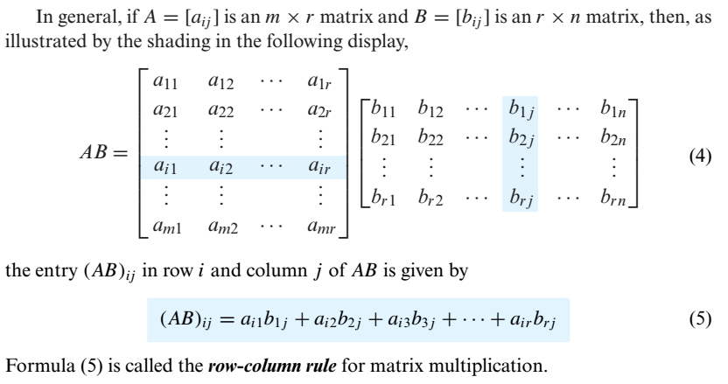

Slide 14

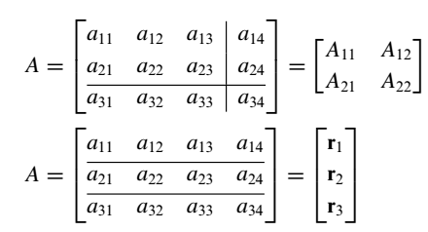
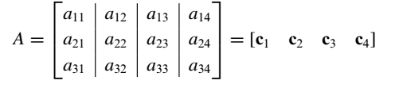
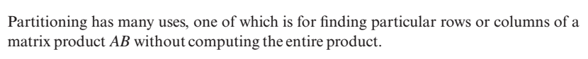
e.g

Slide 15

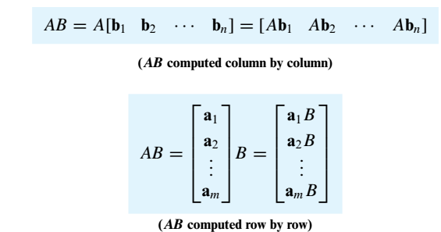

Slide 16
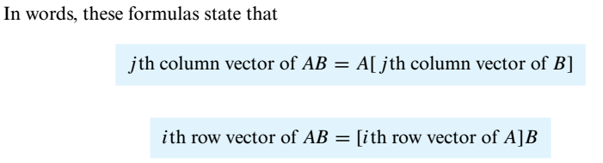
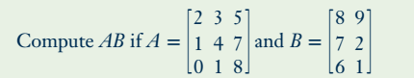
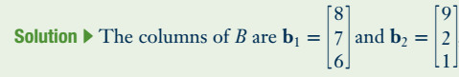
Problem

Slide 17
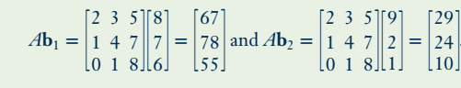
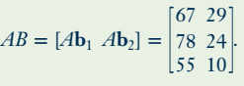

Slide 18
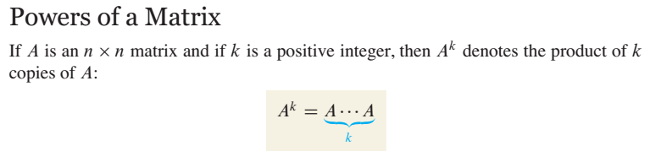
For instance , in order to find $A^{2}$ we will multiply $A$ with $A$.

Slide 19
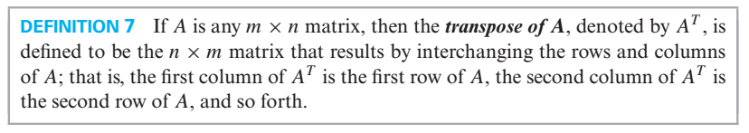
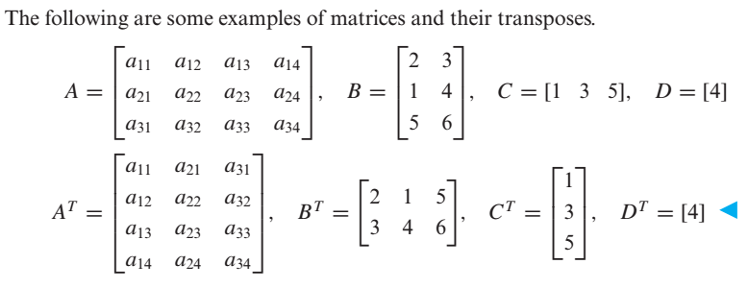
Transpose of a Matrix

Slide 20
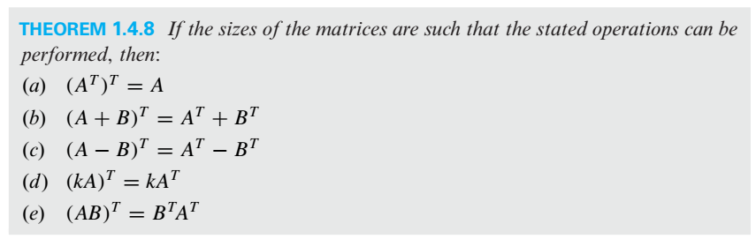
Properties of Transpose

Slide 21
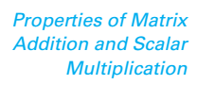
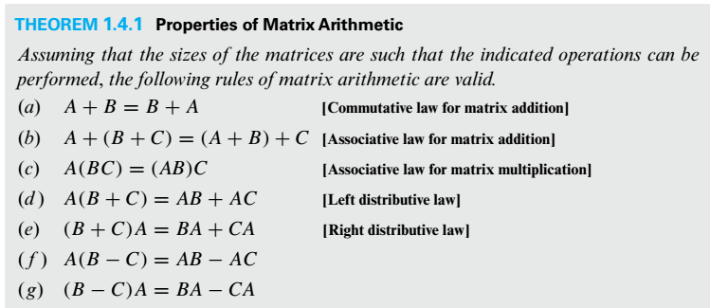

Slide 22
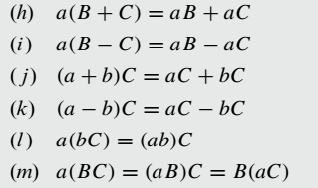

Slide 23
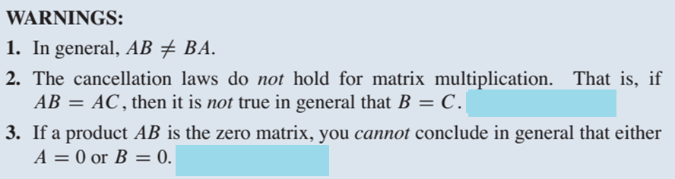
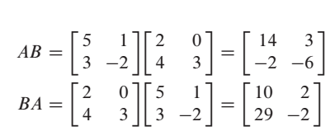
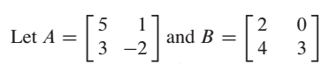
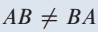
Example on Point 1

Slide 24
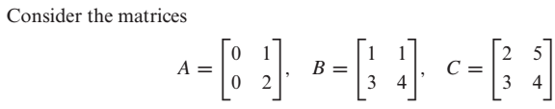
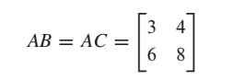
Example on Point 2
Here
But

Slide 25
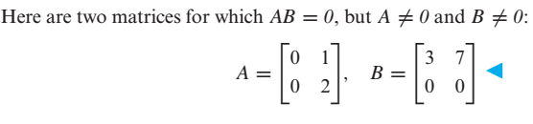
Example on Point 3

Slide 26

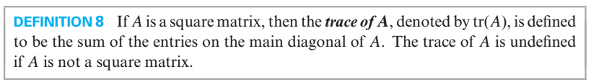
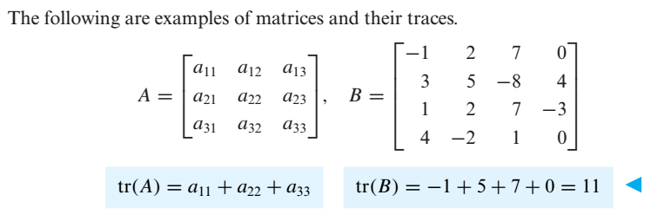

Slide 27
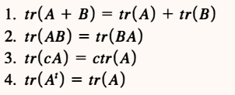

Slide 28

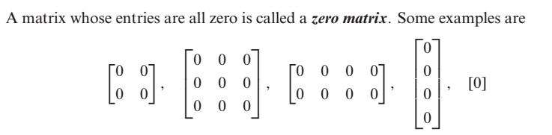

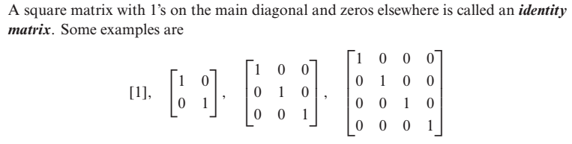

Slide 29

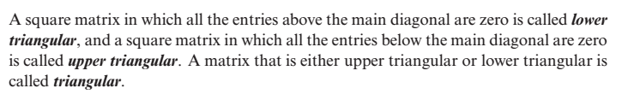


Slide 30




Slide 31


Slide 32





Equivalent Matrices
e.g $I_{2}$and the matrix
are equivalent because we can obtain A from identity matrix by multiplying row 2 by -3
Elementary Matrix

Slide 33


Slide 34


Determinants
For 2×2 Matrices the formula is
Let’s talk about minor and cofactor of an element with the help of which we will calculate determinants of higher order matrices.

Slide 35




Minor & Cofactor of an element (In a Square Matrix)

Slide 36


Slide 37



Slide 38



Problem
By cofactor expansion along the first Row

Slide 39


By cofactor expansion along the first coulmn

Slide 40



Slide 41

e. g

Slide 42



Slide 43



Slide 44



Slide 45




Slide 46




Slide 47



Slide 48



Slide 49




Slide 50



Slide 51



In general

Slide 52

Evaluating Determinants by Row Reduction

Slide 53




Slide 54




Slide 55



Slide 56



Slide 57





Slide 58



Slide 59


Slide 60





Inverse of a 2 $×$ 2 Matrix

Slide 61


Slide 62





Problem
Find the inverse of the matrix
Sol
Another method for finding inverse of a matrix is illustrated in the coming slides.

Slide 63



Slide 64


Slide 65



Slide 66


Slide 67


Note

Slide 68



Slide 69





Slide 70


Slide 71





Slide 72

General Form of a Diagonal Matrix

Slide 73


Inverse of a Diagonal Matrix
Power of a Diagonal Matrix

Slide 74


Slide 75


A matrix is said to be in Echelon form if it has the following properties
Every nonzero row precedes every zero row.
In each successive nonzero row, the number of zeros before the leading entry of a row
increases row by row.

Slide 76





Slide 77


Rank of a Matrix
The number of nonzero rows in the echelon form of a matrix is called rank of the matrix.

Slide 78






Linear System
is a solution of

Slide 79


In matrix form, we can write ( ) as
where,
A is called the

Slide 80


Slide 81




Slide 82


Slide 83

Important Points about Linear Systems
There are a lot of methods for solving linear systems, some methods work in special cases while some works for every type of linear system.
If in a linear system the number of equations is equal to the number of unknowns ( i.e. if the coefficient matrix is a square matrix i.e. if m = n ) then from determinant we can comment about the number of solution(s).
Any linear system in which $m=n$, and $\left|A\right|≠0$, has a unique solution. We can obtain this
unique solution by any of the following methods:
(i) Matrix Inversion Method (ii) Cramer's Rule
(iii) Gauss Elimination (iv) Gauss-Jordan Elimination
Furthermore, if the system is homogeneous then this unique solution is the trivial solution
(zero solution).

Slide 84

A homogeneous system has always a zero solution called trivial solution. Thus a homogeneous system is always consistent.
A homogeneous linear system in which $m=n$, and $\left|A\right|=0$, has infinite solutions ( i.e.
nontrivial solutions also exist).
5. In case of nonhomogeneous linear system in which $m=n$ and $\left|A\right|=0$, there is possibility
that the system has
(i) No Solution (ii) Infinite Solutions
6. If in a linear system the number of equations is not equal to the number of unknowns ( i.e. if
the coefficient matrix is not a square matrix i.e. if m $≠$n ) then we can comment about the
number of solution(s) by looking into the rank of coefficient matrix, rank of augmented
matrix and number of unknowns in the system. In this case we can find the solution(s) (if
exist) by either Gauss Elimination or by Gauss-Jordan Elimination.

Slide 85


Slide 86

(Because for homogeneous linear system Rank of the coefficient matrix is always equal to Rank of the augmented Matrix and if number of equations is less than unknowns this mean that common rank < n, so by third part of fundamental theorem, system will have infinite solutions.

Slide 87


Methods for solving a linear System
(or Gauss Elimination)

Slide 88


Problem

Slide 89





Slide 90





Slide 91





Slide 92



Slide 93




Slide 94




Slide 95



Slide 96


Slide 97


Slide 98


Problem

Slide 99


If we reduced the augmented matrix to reduce echelon form we have

Slide 100


Slide 101


Slide 102


Problem

Slide 103


Slide 105




e.g.

Slide 106






Slide 108



Slide 109




Slide 110


Slide 111


Slide 112


Slide 113


Slide 114


Slide 115



Slide 116


Slide 117


Slide 118




Slide 119


Slide 120



Slide 121







Slide 122





Slide 123




Slide 124



Slide 126




Slide 127



Slide 128



Linear Combination

Slide 129




Slide 131


Slide 132
Problem

Slide 133


Slide 134


Spanning Set

Slide 135



Two Major Problems to Address
Problem

Slide 136



Slide 137


Slide 138




Slide 139


Slide 140





Slide 141



Slide 142


Problem

Slide 143


Slide 144

Problem

Slide 145



Slide 146



Slide 147



Slide 148



Slide 149



Slide 150

Wronskian

Slide 151


Slide 152



Slide 153




Slide 154



Slide 155


Slide 156


Slide 157




Slide 158



Slide 159



Slide 160


Dimension

Slide 161


Slide 162


Slide 163


Slide 164



Slide 165



Slide 166



Slide 167


Problem

Slide 168


Slide 169


Problem

Slide 170



Slide 171





Slide 172


Problem
Solution

Slide 173


Slide 174


Slide 175



Problem

Slide 176



Slide 177


Slide 178



Slide 179



Problem

Slide 180




Slide 181




Slide 182



Slide 183


Problem

Slide 184
Quiz -2

Slide 185


Slide 186


Slide 187


Slide 188
Assignments -2
Ex-4.1 to Ex.4.8
Due date of submission
9/11/2021

Slide 189



Slide 190



Slide 191




Slide 192



Slide 194



Slide 195



Slide 196


Slide 197



Slide 198



Slide 199


Slide 201




Slide 202


Slide 204


Practice Problems

Slide 205

Norm of a vector and Distance b/w two vectors in an Inner Product Space

Slide 206



Slide 207



Slide 208



Slide 209


Slide 211




Slide 212




Slide 214

Technique for making an orthogonal set an orthonormal Set

Slide 215



Slide 216

Problem

Slide 217


Simply speaking, orthogonality implies linear independency

Slide 218


Slide 219




Problem

Slide 220






Slide 221


Slide 222


Practice Problem

Slide 223




Slide 224


Slide 225

See slide on page 176

Slide 226



Slide 227


Slide 228


Slide 229



Slide 230



Slide 231


Slide 232


Slide 233


Slide 234


Slide 235



Slide 236


Problem
Also find least squares error vector and least square error.
Sol:

Slide 237




Slide 238


Slide 239


Problem

Slide 240



Slide 241


Slide 242

Note

Slide 243

Practice Problem

Slide 244



Slide 245


Slide 246


Slide 247



Slide 248


Slide 249


Slide 250

Problem

Slide 251


Slide 252




Slide 253

Problem

Slide 254




Slide 255




Slide 256



Slide 257



Slide 258



Slide 259


Slide 260


Slide 261


Slide 262


Slide 263


Slide 264




Slide 265

In short

Slide 266

Problem

Slide 267



Slide 268




Slide 269



Slide 270


Slide 271

Practice Problem

Slide 272


Slide 273


Slide 274


Slide 275


Slide 276


Slide 277


Slide 278


Slide 279


Slide 280

Problem

Slide 281


Slide 282


Slide 283

The question is : How to find the eigenvalues and eigenvectors of a given matrix.

Slide 284


Slide 286


Slide 287


Problem

Slide 288



Slide 289


Slide 290


Problem

Slide 291




Slide 292



Slide 293




Slide 294



Sated anther way, the eigenspace of A corresponding to the eigenvalues is the solution space
of the homogeneous system

Slide 295


Problem

Slide 296


Slide 297



Slide 298


Similarly

Slide 299



Slide 300



Similar Matrices

Slide 301





and
are similar matrices
because there is
such that

Slide 302

Diagonalizable Matrix
e.g
is diagonalizable
A is similar to the diagonal matrix
( Detail in previous Slide)

Slide 303


Slide 304


Slide 305


Problem

Slide 306




Slide 307



Slide 308



Slide 309



Slide 310




Slide 311



Slide 312


Problem

Slide 313




Slide 315


Slide 316




Slide 317


Slide 318





Slide 319



Slide 320




Problem
( Previous Slides )

Slide 321



Slide 322



Slide 323


Slide 324



Slide 325


Slide 326



Problem

Slide 327



Slide 328


Slide 329




Slide 330


Slide 331


Slide 332

Problem

Slide 333


Slide 334

Problem

Slide 335



Slide 336


Slide 337



Slide 338


Slide 339


Slide 340


Slide 341


Slide 342


Slide 343


Slide 344

Problem

Slide 345


Slide 346



Slide 347


Slide 348



Slide 349

Problem

Slide 350


Slide 351


Slide 352




Problem

Slide 353



Slide 354


Slide 355


Problem

Slide 356


Slide 357


Problem

Slide 358



Slide 359
Practice Problem

Slide 360




Slide 361


Slide 362


Slide 363


Slide 364


Slide 365


Slide 366



Slide 367



Slide 368

Now since every linear transformation from $R^{n}$ to $R^{m}$ is a matrix transformation and for a matrix transformation there should be a matrix which when multiplied with any domain vector give image. We will call such matrix the standard matrix for the linear transformation.

Slide 369


Method for finding standard Matrix for a Linear Transformation from $R^{n}$ to $R^{m}$

Slide 370



Problem

Slide 371




Slide 372

Practice Problem

Slide 373



Slide 374




Problem

Slide 375



(Because determinant of the standard matrix for T is non zero)

Slide 376


Slide 377


Slide 378


Slide 380


Slide 381



Slide 382


Practice Problem 1

Slide 383


Practice Problem 2
Answers

Slide 384





Slide 385



Slide 387
The End

